Slide 2
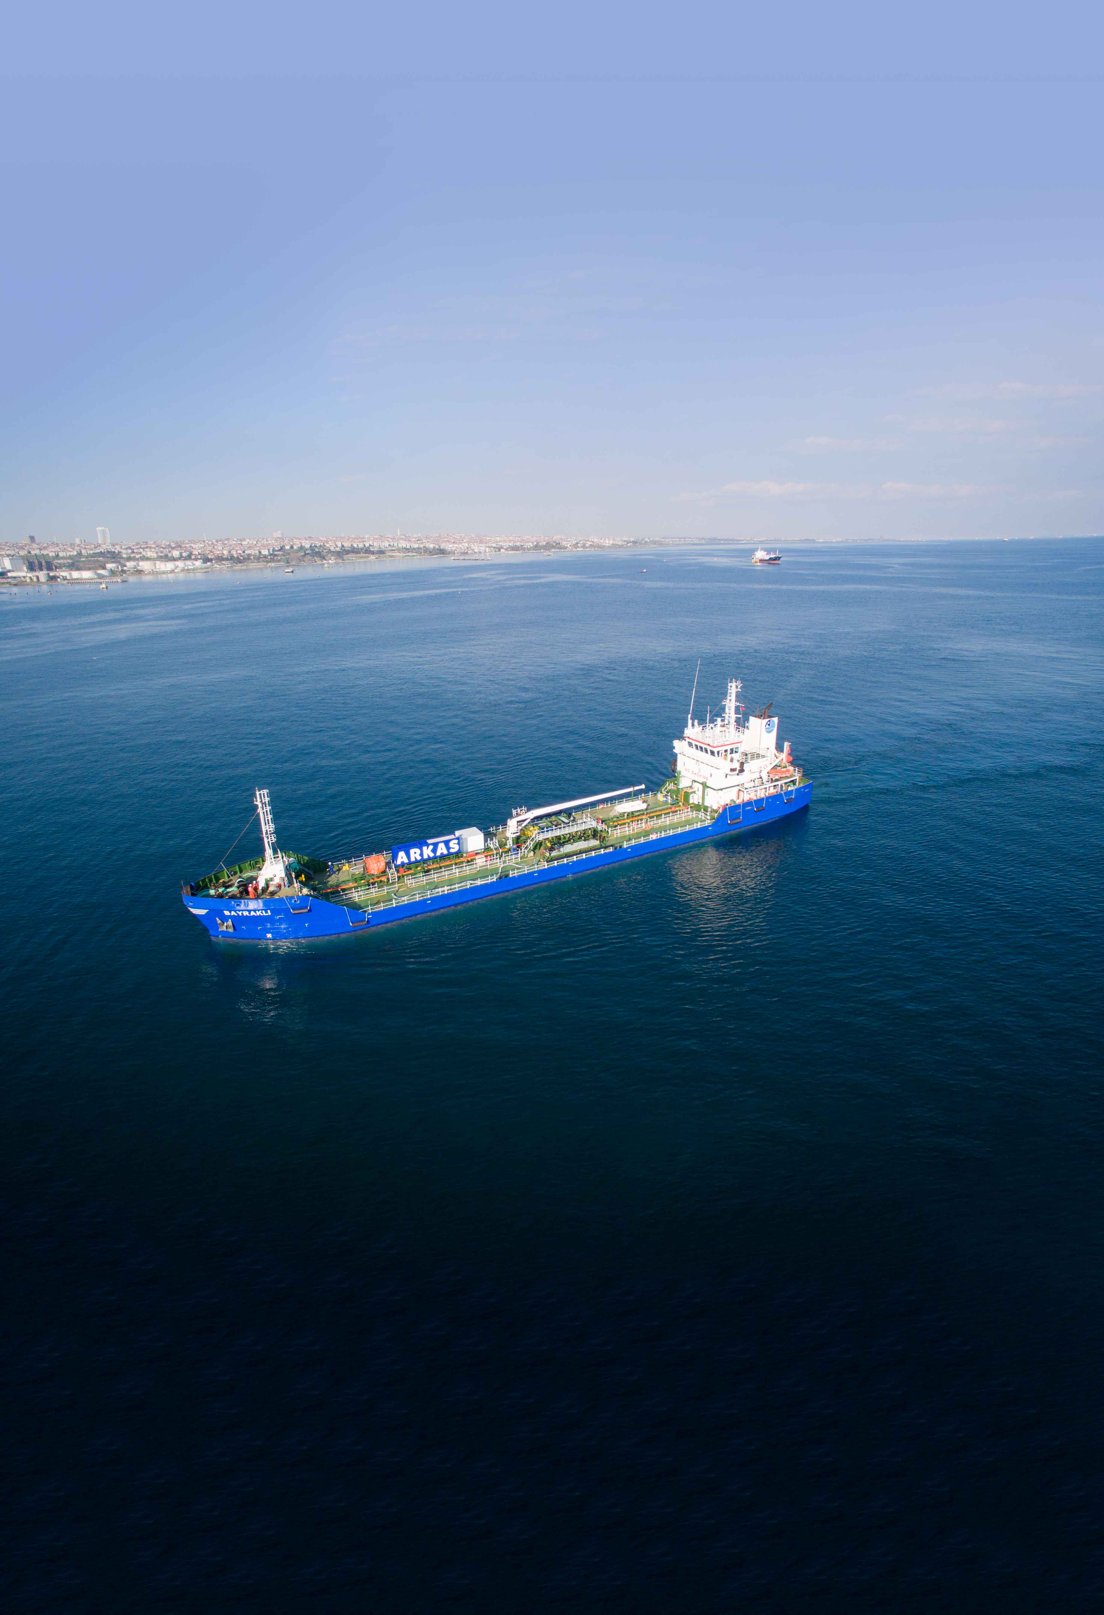
About Us
Operating since 2006, Arkas Bunker provides fast and reliable marine fuel supply services, built on the trust and quality associated with the Arkas brand. With a fleet of six double-hull tankers, all owned by the company and compliant with international standards, Arkas Bunker has supplied fuel to over 25,000 vessels to date.
As a pioneer in sustainability, Arkas Bunker is a member of the International Bunker Industry Association (IBIA) and is the first company in Türkiye to be awarded the International Sustainability and Carbon Certification (ISCC) in the marine fuels sector. The company also carried out Türkiye’s first biofuel supply.
Thanks to its strong collaborations and expert team, Arkas Bunker will continue to be your reliable partner in sustainable marine fuels, offering environmentally friendly services while prioritizing customer satisfaction, without compromising business ethics, and discipline.
ABOUT US

Slide 3
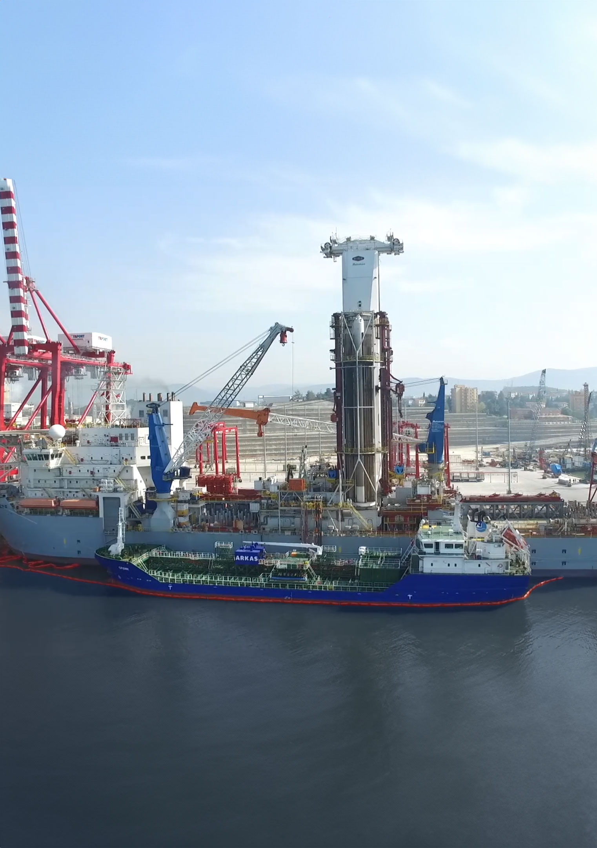
Our Services
With its expertise and reliability, Arkas Bunker provides services at ports worldwide:
Physical Marine Fuel Supply
i. Fuel Oil
ii. Marine Gas Oil
iii. Biofuels
Lubricant and Fuel Supply Brokerage Services
Vessel Chartering Services
OUR SERVICES

Slide 4
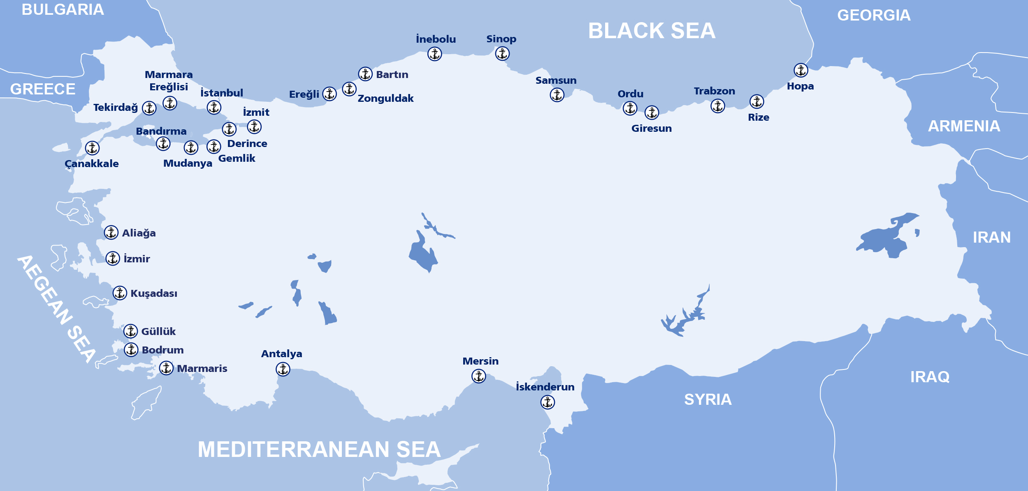
Supply Points
As a physical supplier, we provide top-quality service to vessels using our own double-hull tankers that meet international standards
Moreover, we supply fuels via trucks at all Turkish ports.
TÜRKİYE

Slide 5
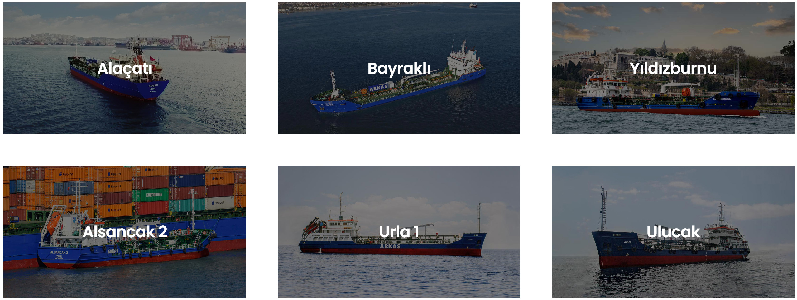
Our Fleet
From 2006 until today, we have successfully supplied 6.4 million tons of fuels to over 25 thousand vessels.
4139 DWT
3799 DWT
1770 DWT
1763 DWT
1646 DWT
1634 DWT

Slide 6
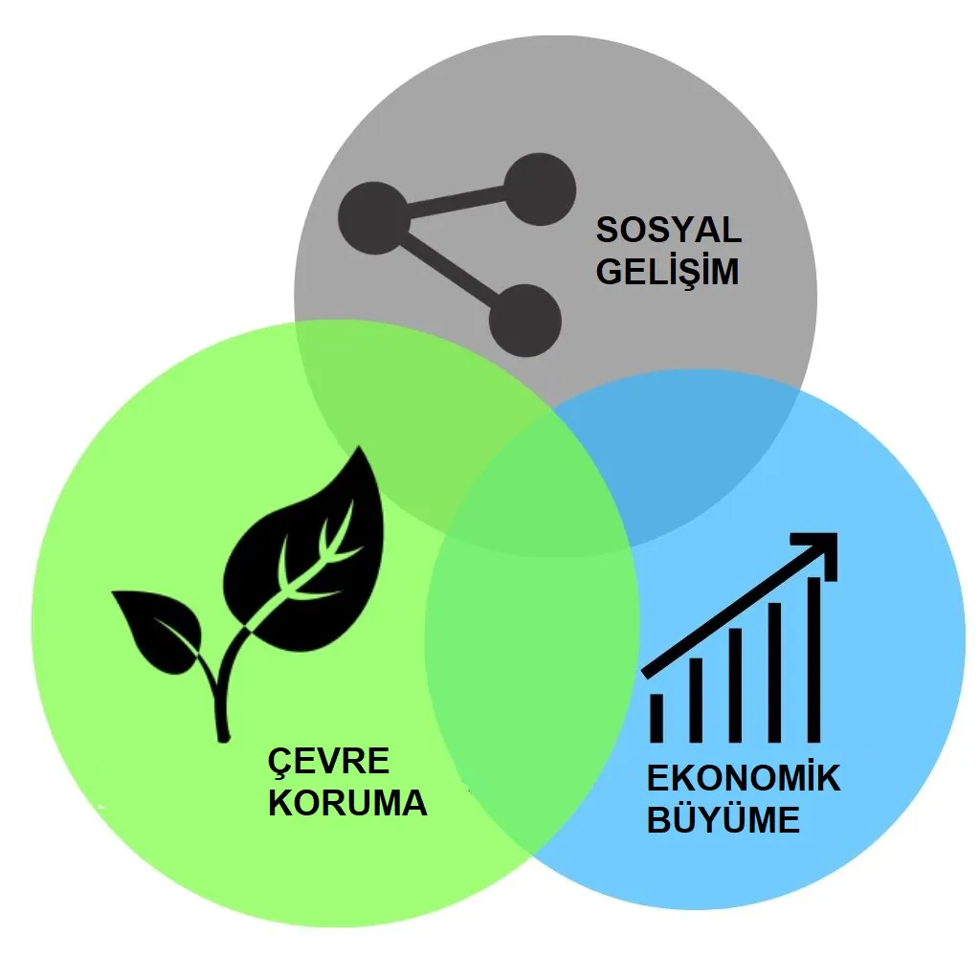
Sustainability
In the broadest sense, sustainability refers to the ability to maintain and support a process consistently over time. Sustainability aims to prevent the exhaustion of natural and physical resources and thus ensure they stay available in the long term.
Sustainability is the ability to maintain or support a process in time.
Sustainability is commonly divided into three key concepts: economic, environmental and social.
Many businesses and governments are committed to sustainable goals such as reducing environmental footprints and protecting resources.
Some investors embrace sustainability investments known as «green investments».
SOCIAL
ENVIRONMENT
ECONOMIC

Slide 7
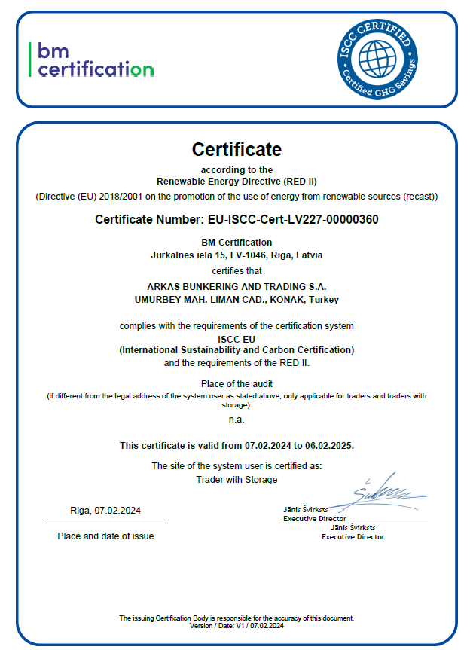
ISCC
In February 2024, Arkas Bunker became Türkiye’s first ISCC-certified marine fuel supplier.
International Sustainability and Carbon Certification (ISCC), is a multi-stakeholder enterprise that provides sustainability certification for all feedstock and markets on a global scale.
ISCC is directed by an association of over 230 members including research institutions, NGOs, industry representatives and the public sector.

Slide 8
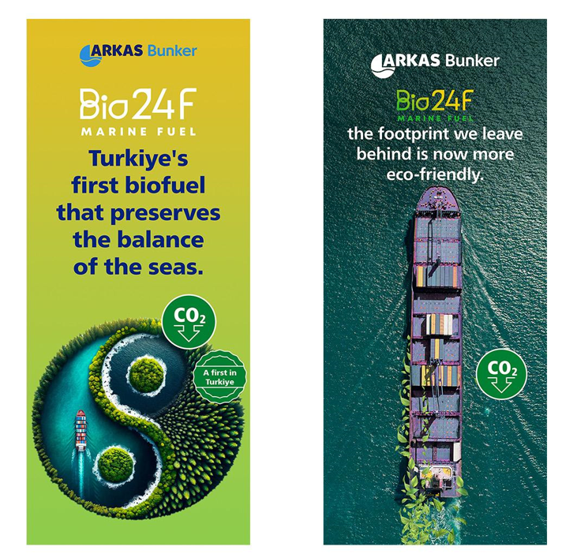
Bio24F
Arkas Bunker product Bio24F refers to the marine fuel obtained by blending 24% used and processed waste vegetable oil (UCOME) certified by ISCC with 76% fuel oil.
The bio component of Bio24F is valuable for its ability to significantly reduce life-cycle carbon emissions compared to traditional marine fuels.
The fuel oil part of the blend complies with the International Maritime Organization’s (IMO) regulations.
Biofuels, derived from biological sources, provide a sustainable alternative to fossil fuels and contribute significantly to the maritime industry’s sustainability goals.

Slide 9
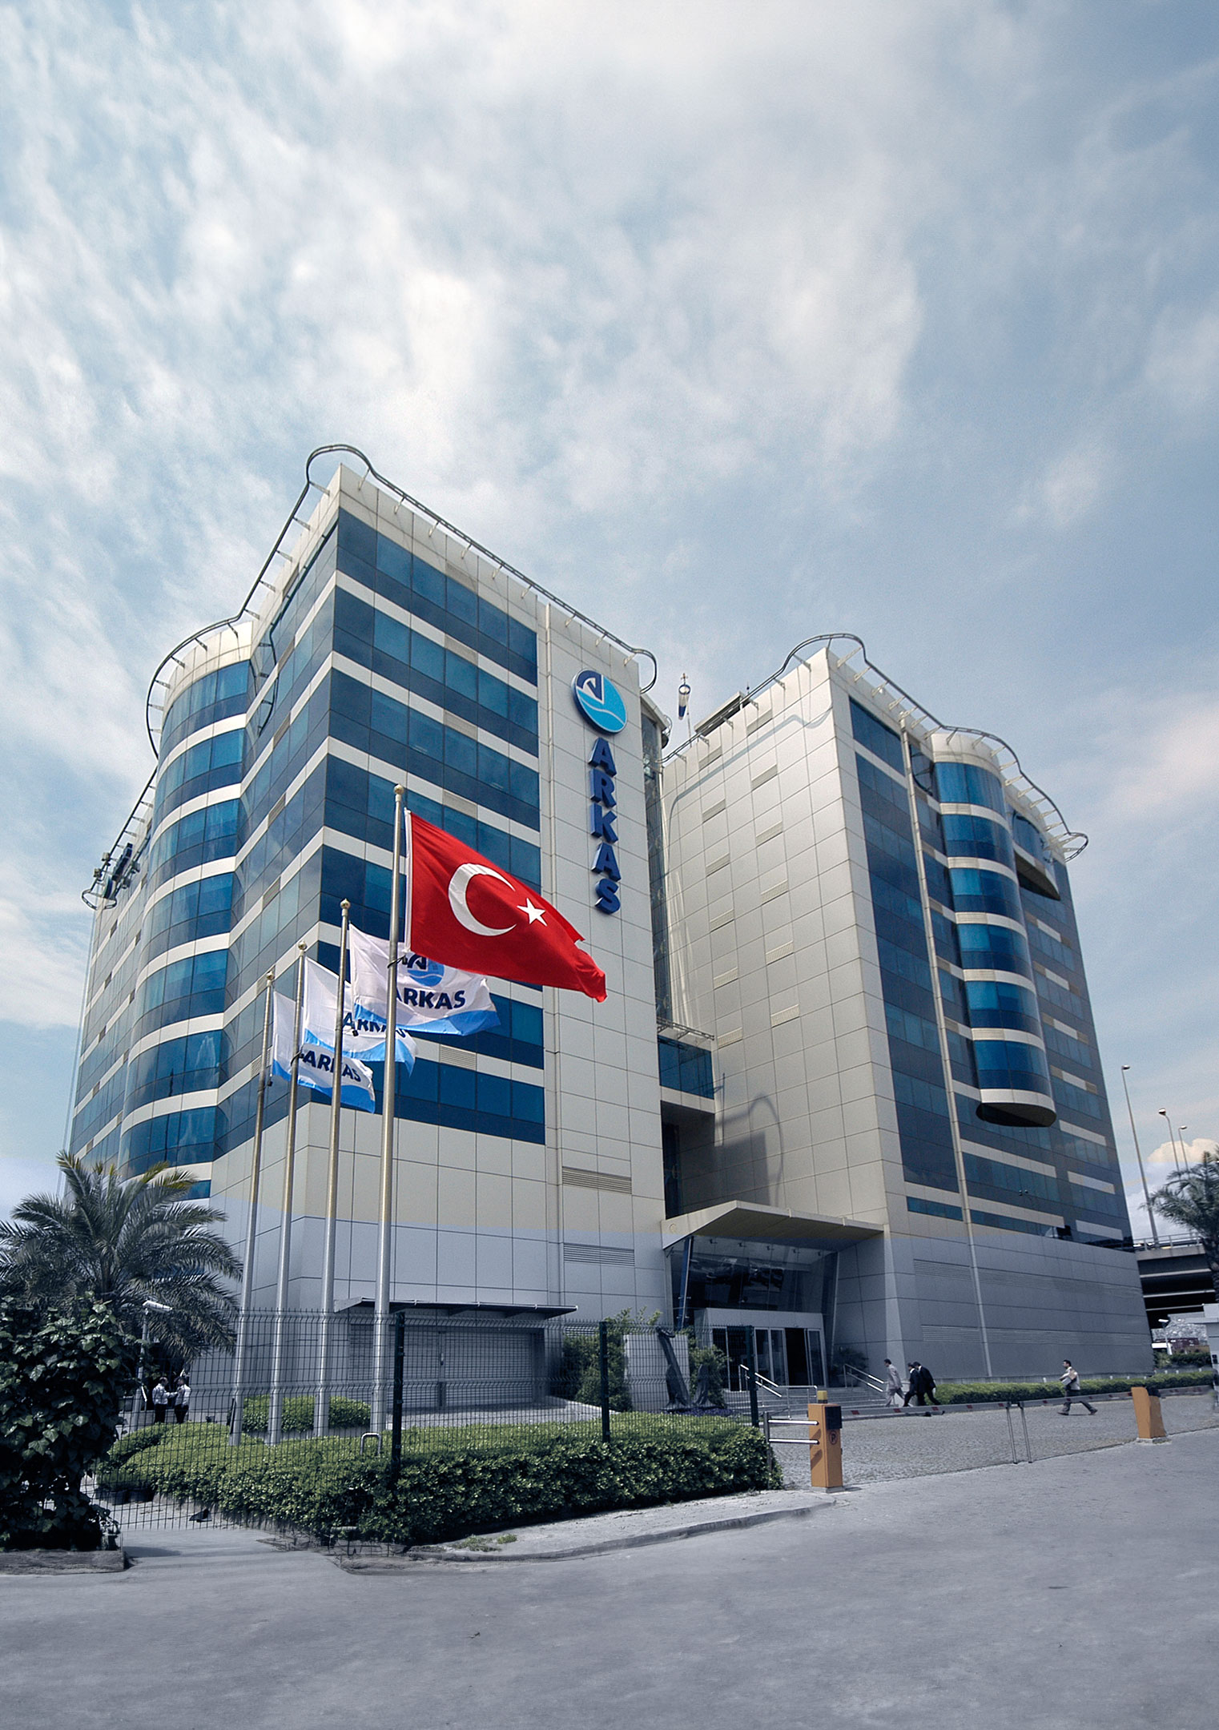
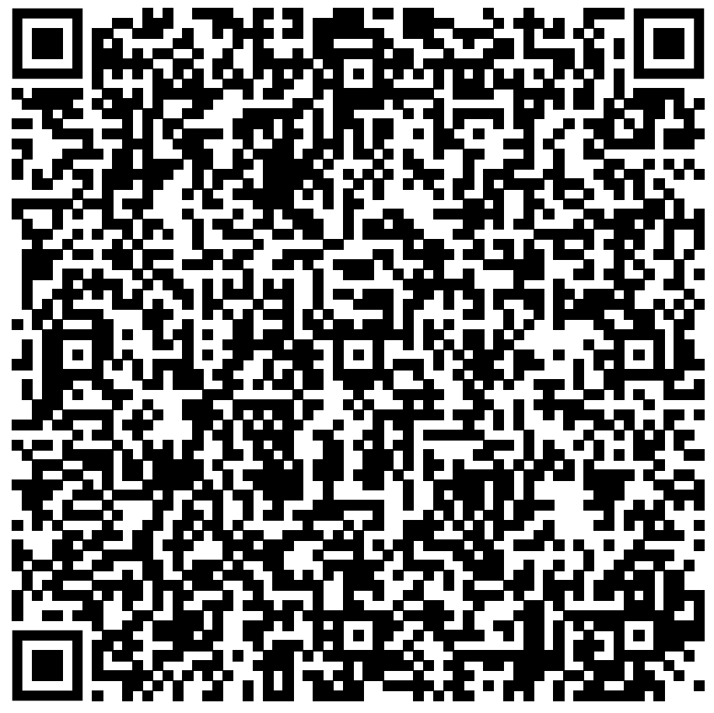
CONTACT INFO
CONTACT
Liman Caddesi Arkas Binasi
No: 38 Alsancak 35230 Izmir/Türkiye
(+90) 232 477 7777
arkasbunker@arkasbunker.com
www.arkasbunker.com
8

Slide 10
THANK YOU

