Slide 1



Slide 2
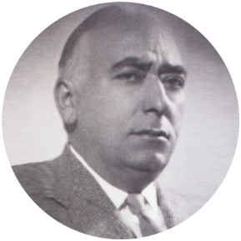
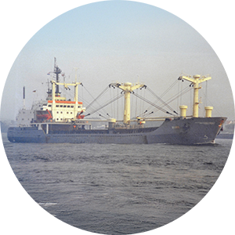
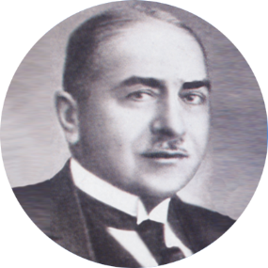

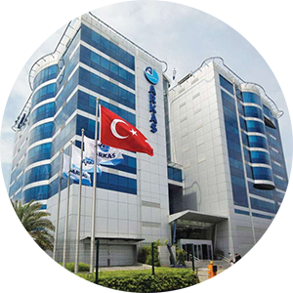
Arkas Chronology
1944
1979
1902
1964
2000
Gabriel J. B. Arcas founded the company in İzmir.
Lucien G. Arcas defined the company's core activity as international transportation.
Lucien Arkas Shipping Agency was founded. Lucien Arkas, 3rd generation family member, took over management.
Name of the company was changed to Arkas Shipping and Transport S.A.
Arkas Holding S.A. was founded in 2000.

Slide 3







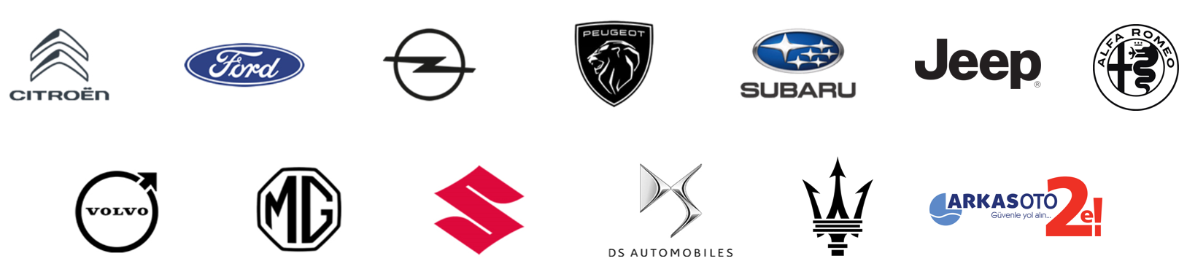



Arkas By Numbers
11
8300
Sectors
Staff
SHIPPING
LOGISTICS SERVICES
TERMINAL OPERATORS
AUTO DEALERSHIP
433,000 m²
Storage Area
MARPORT
AUTOPORT
RAILPORT LIMAR
49
6
1
Container
Vessels
Bunker Barges
Bulk Carrier
14 Warehouses
500
682
5
Trucks
Wagons
Locomotives
(to be delivered in 2025)

Slide 4
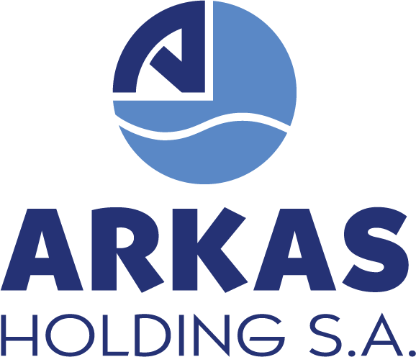

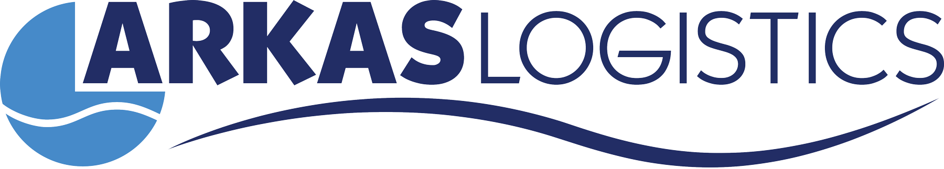
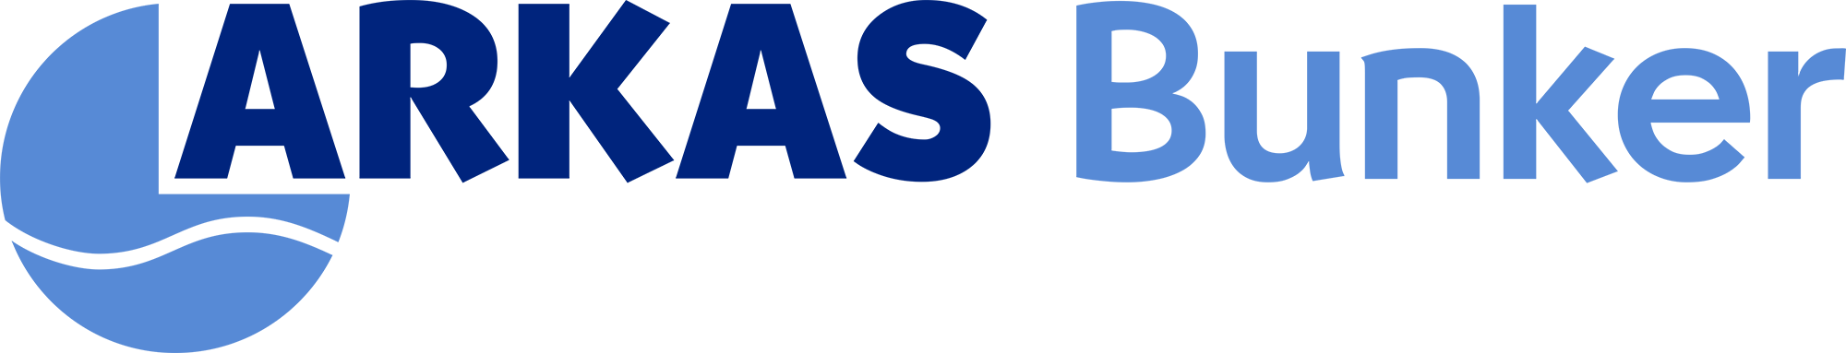
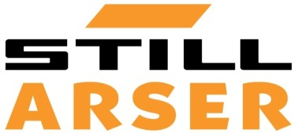
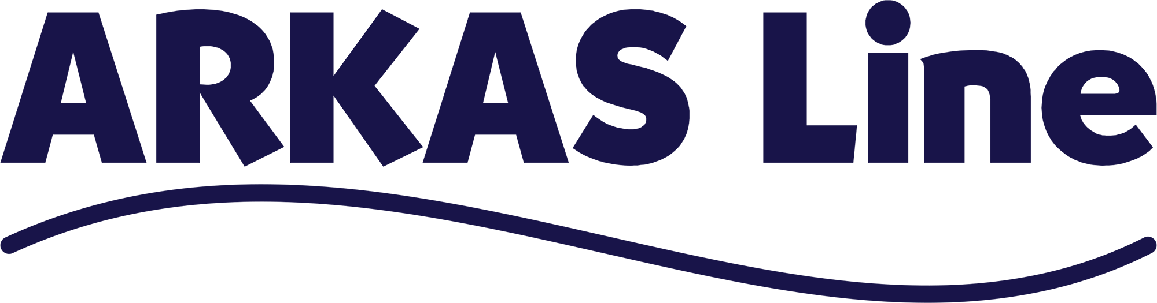
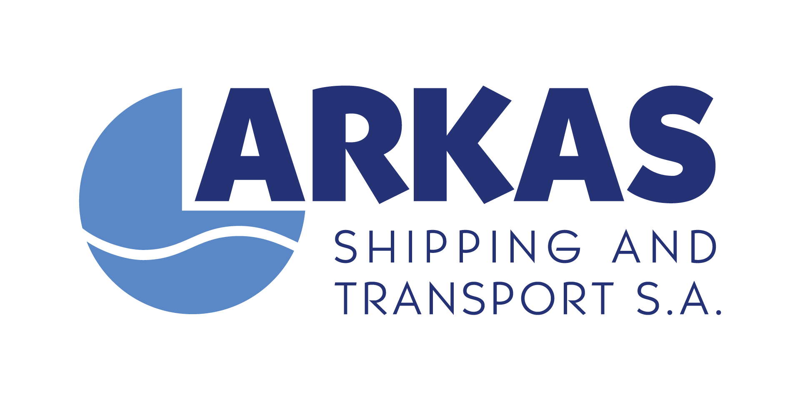
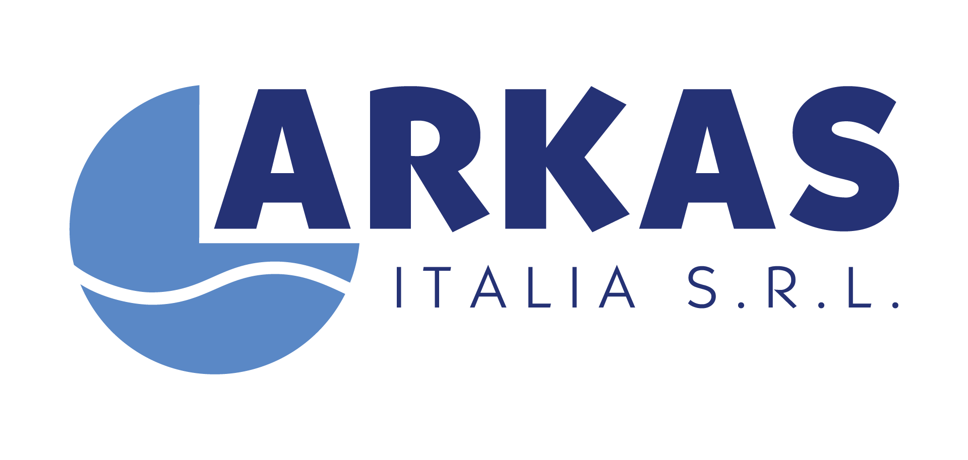
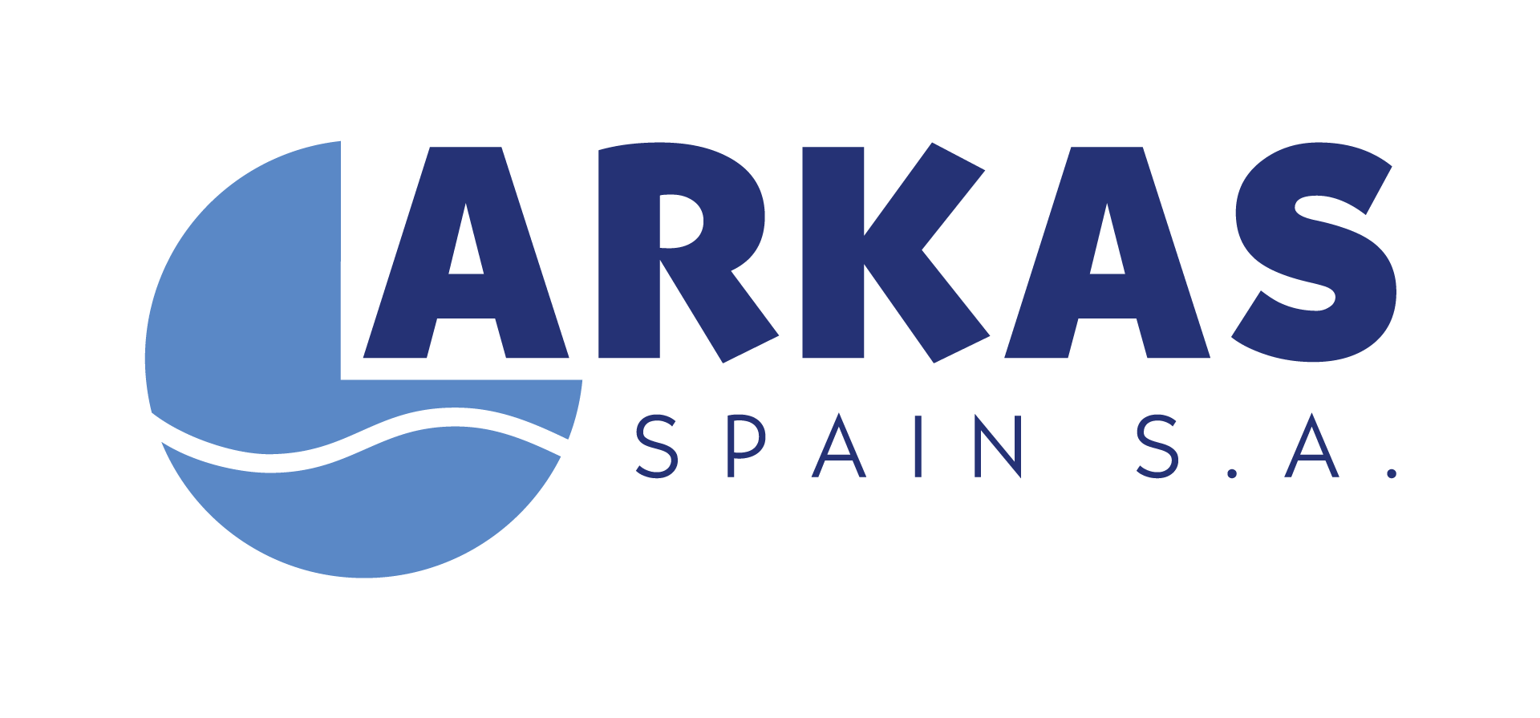

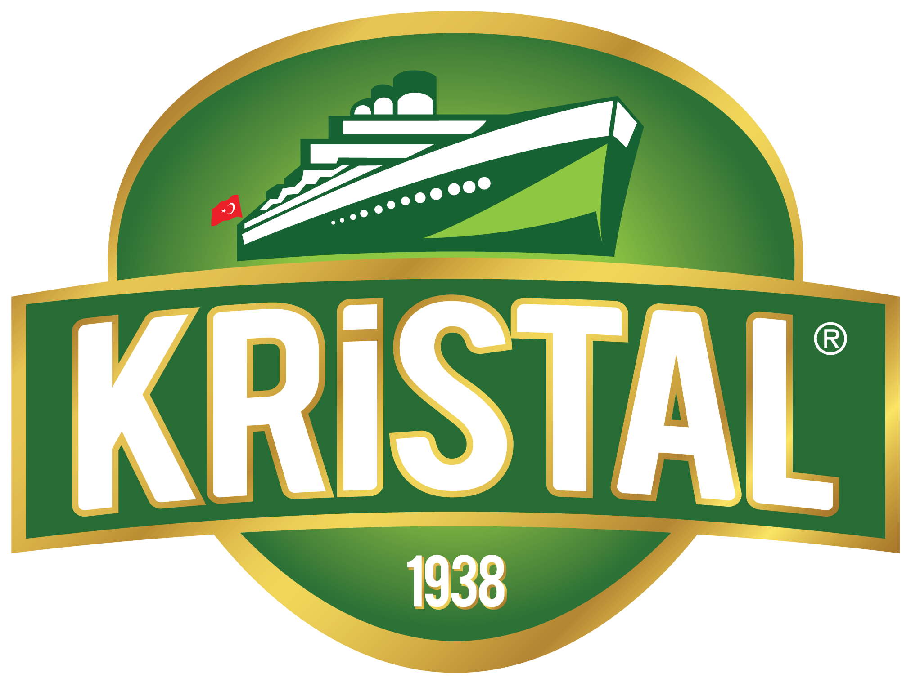
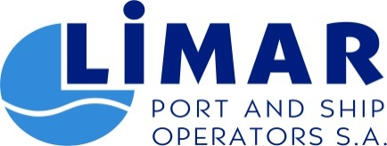
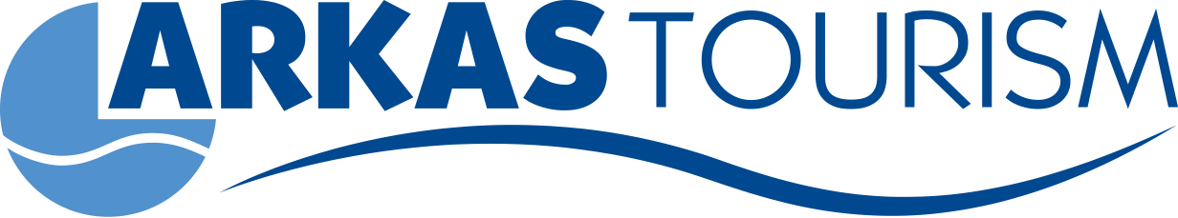
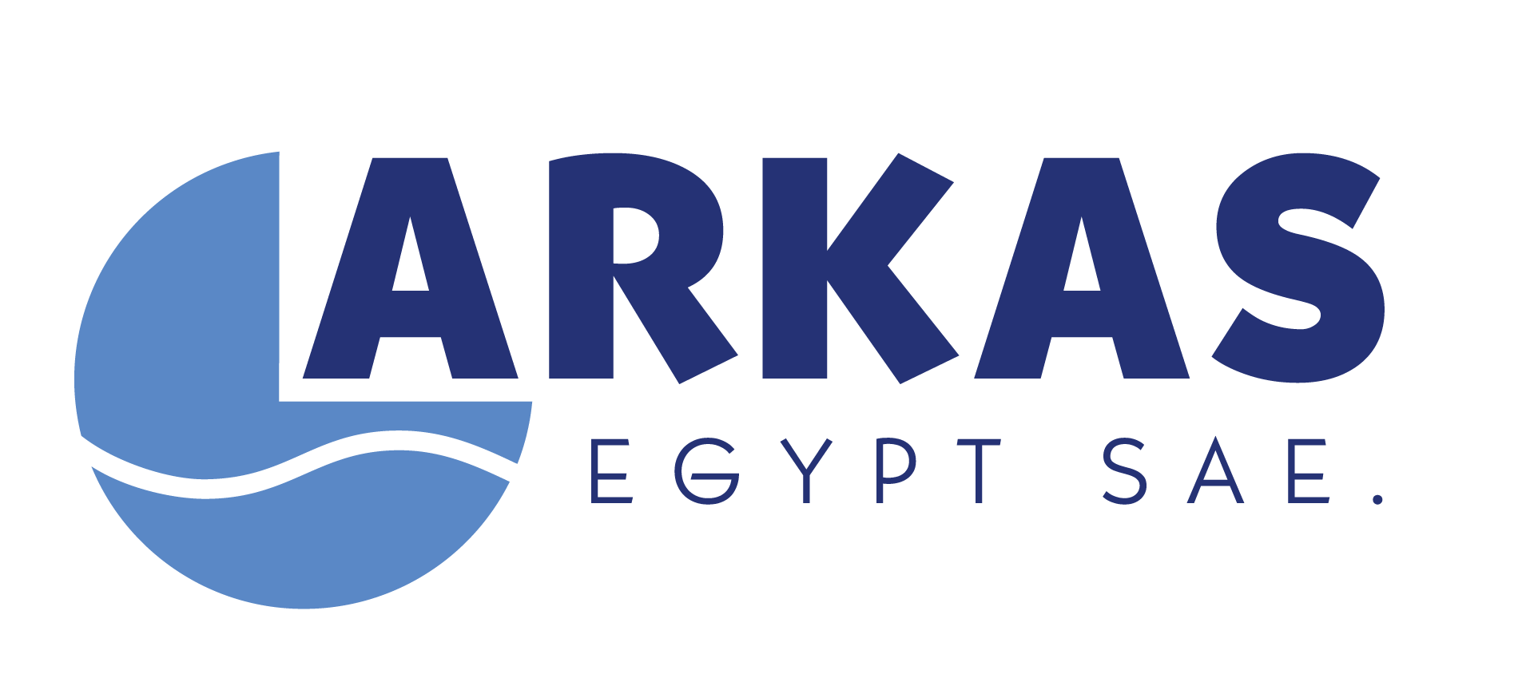
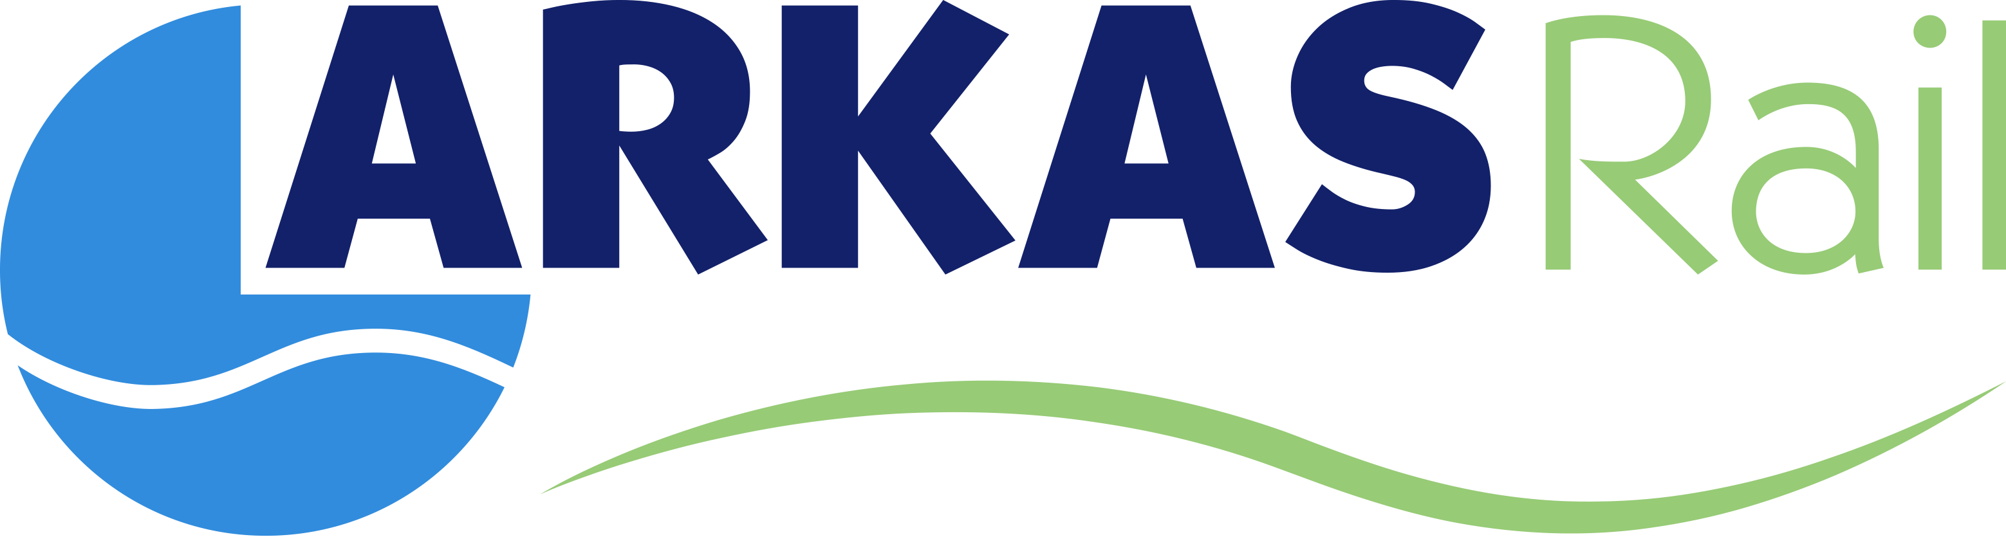
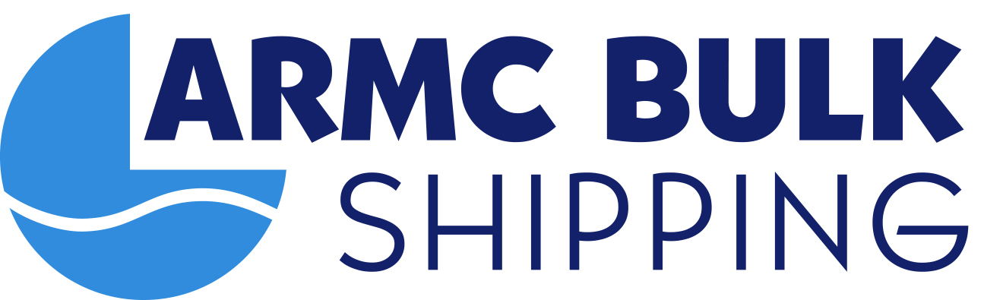
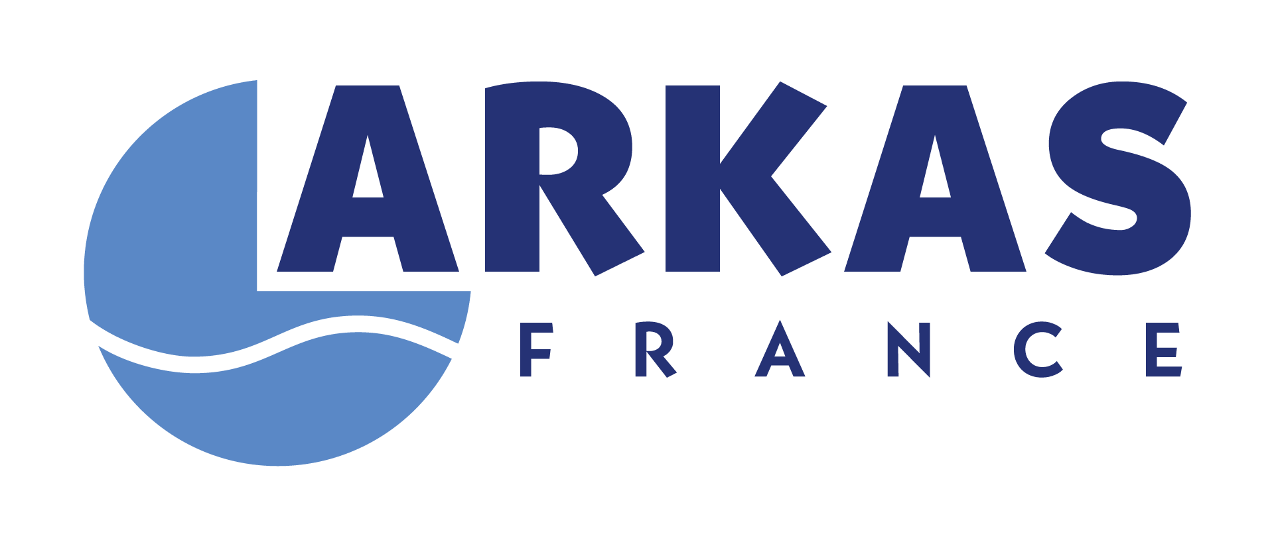
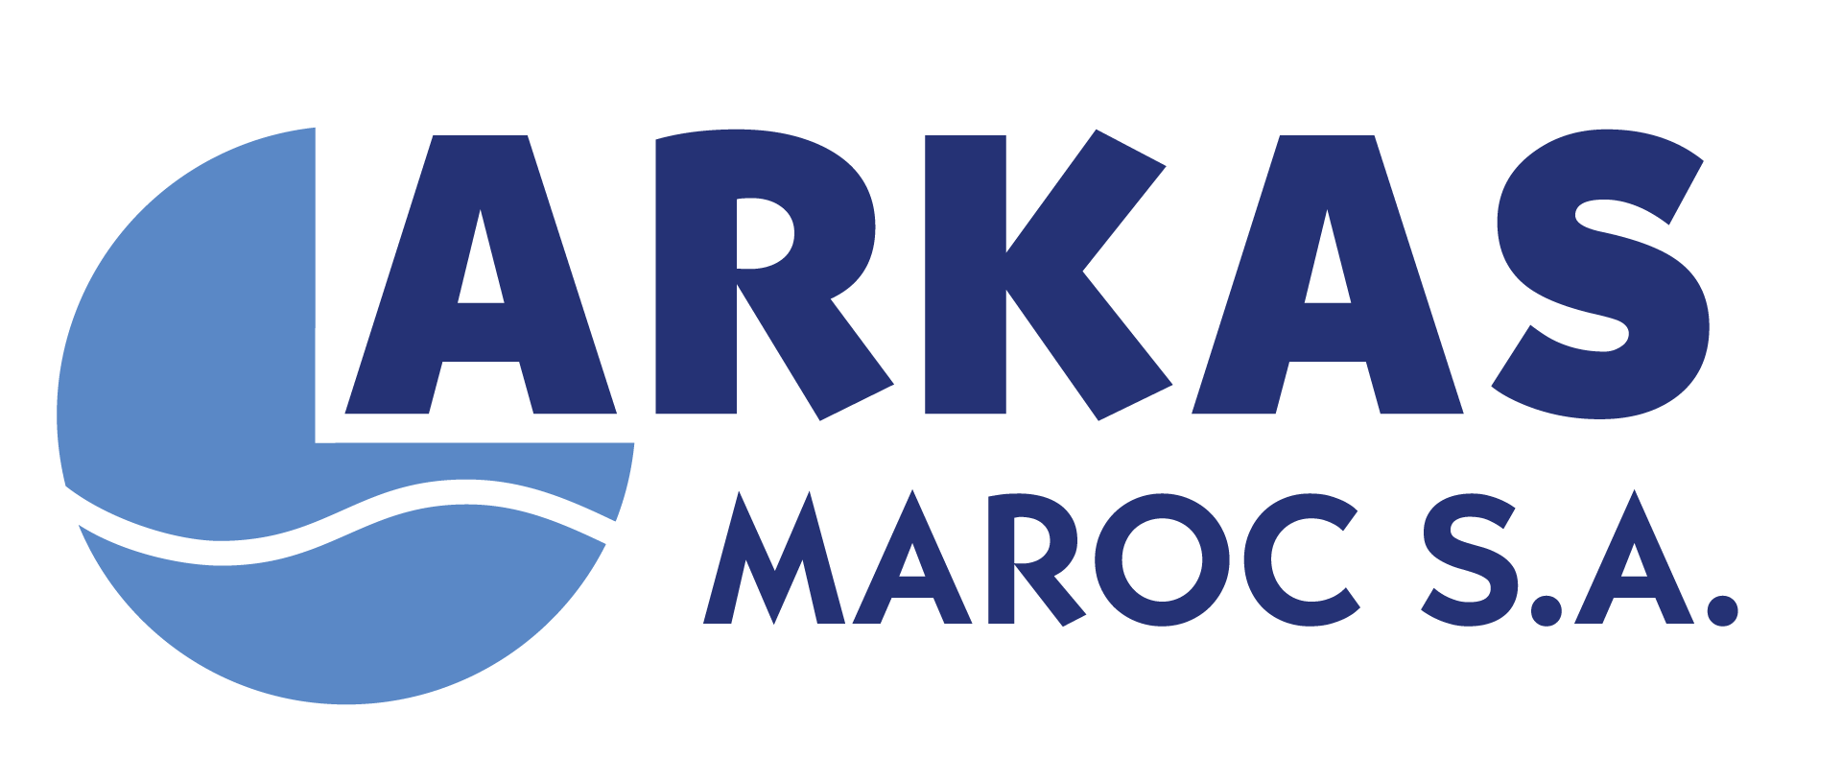
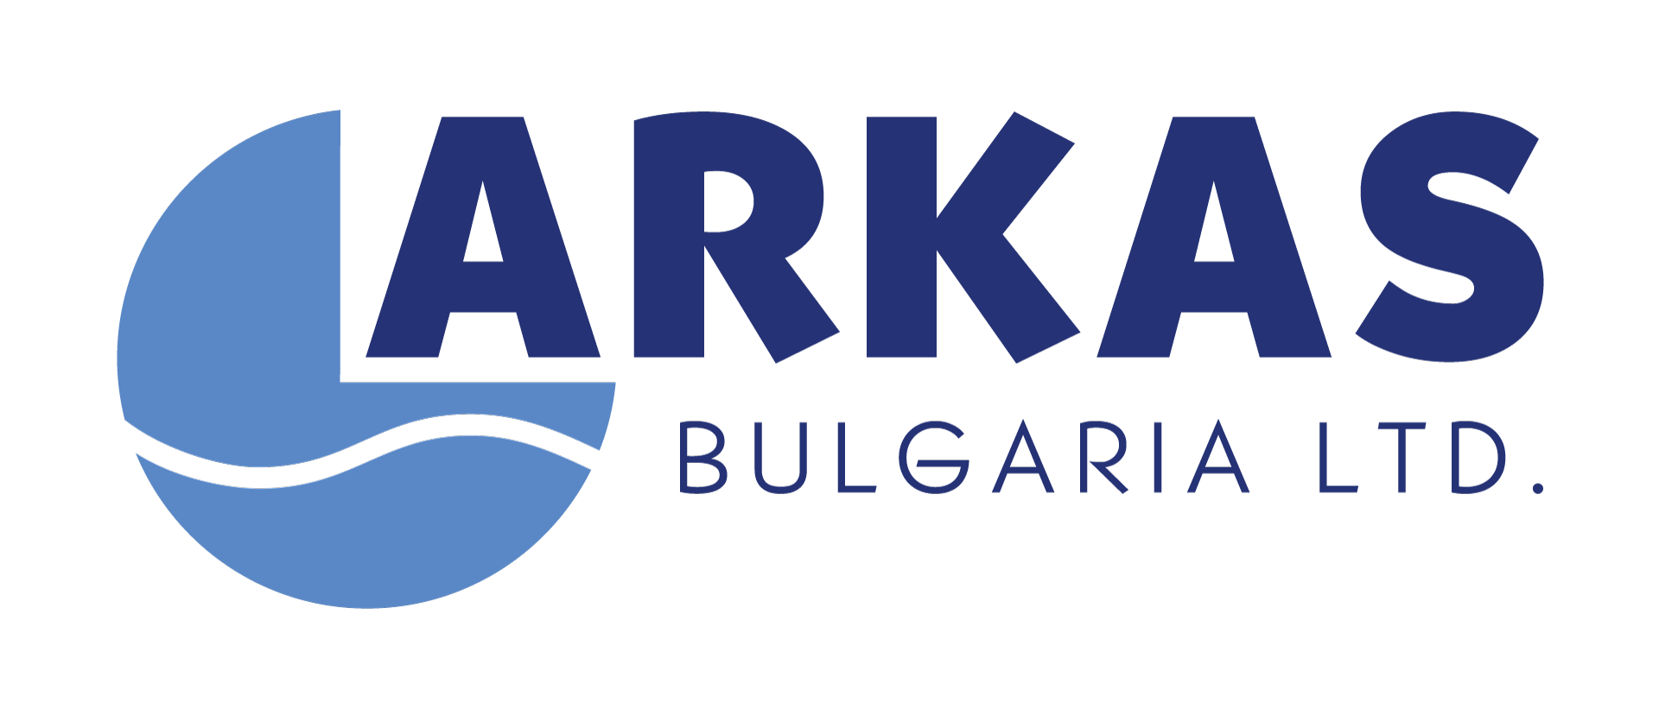
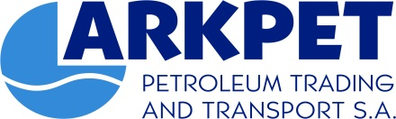

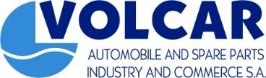
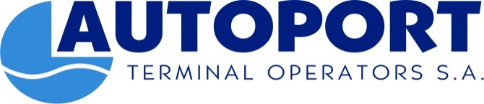
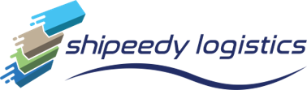
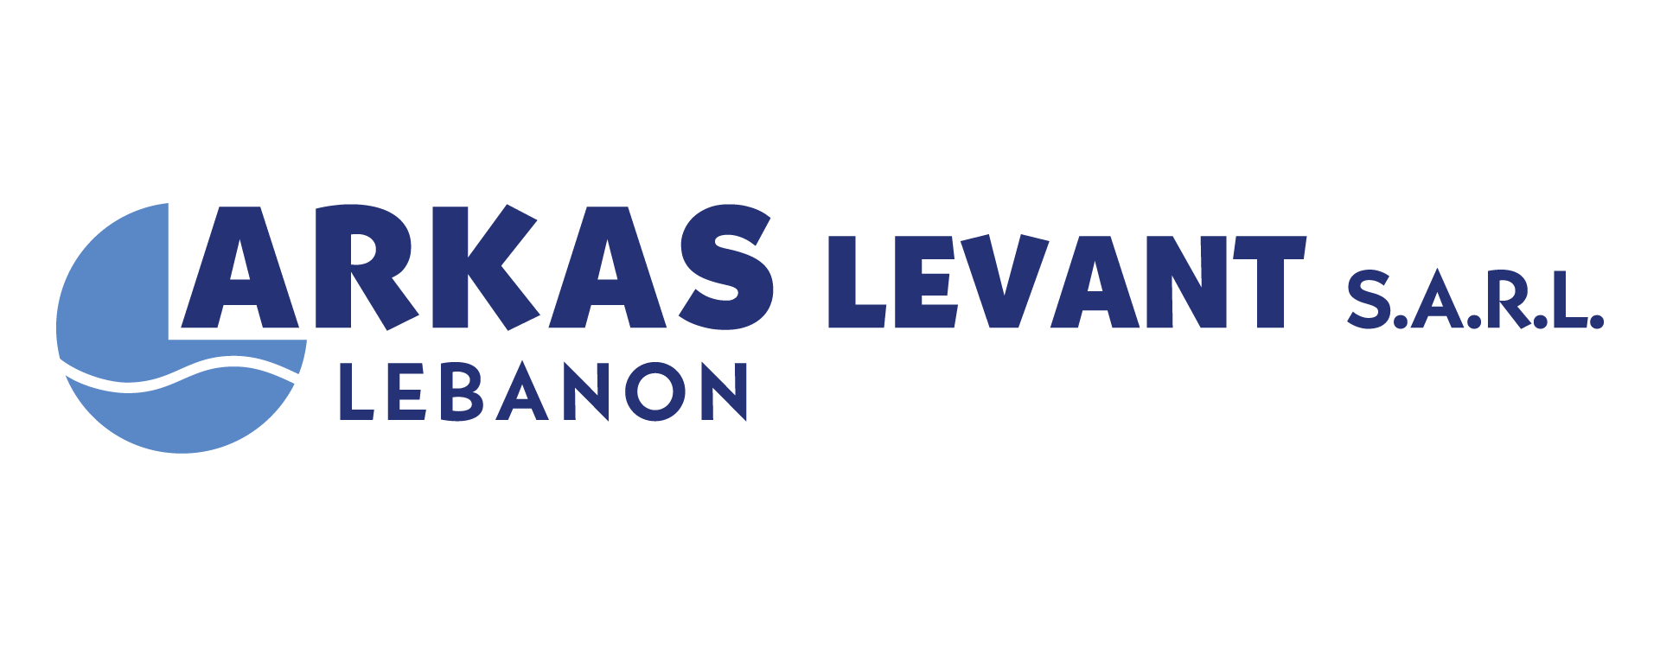
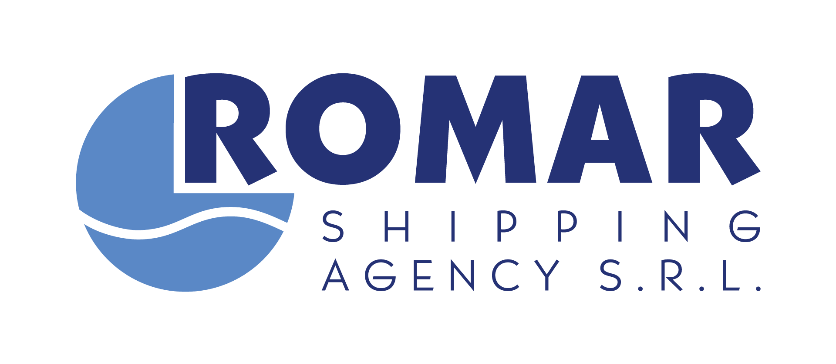
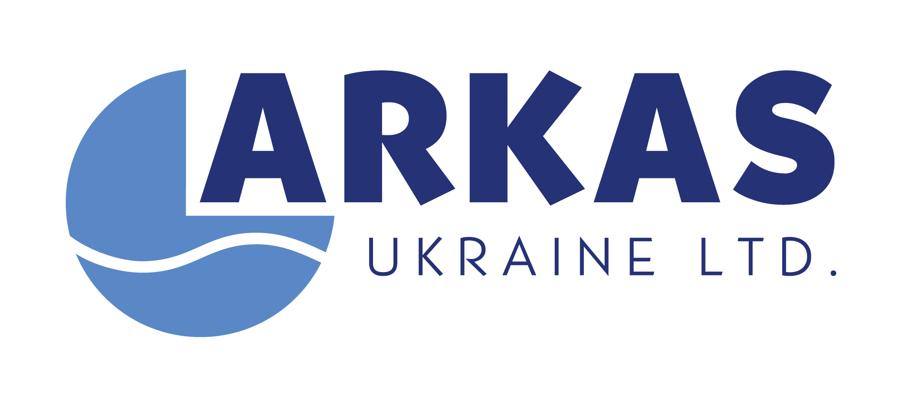


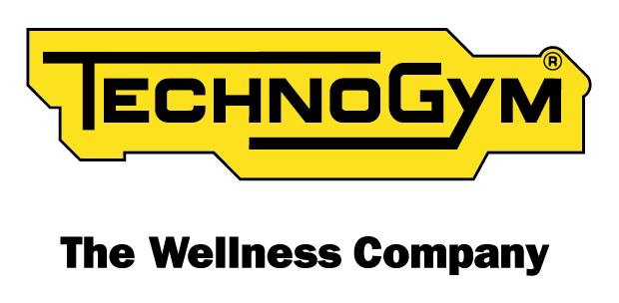
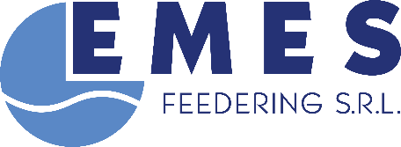
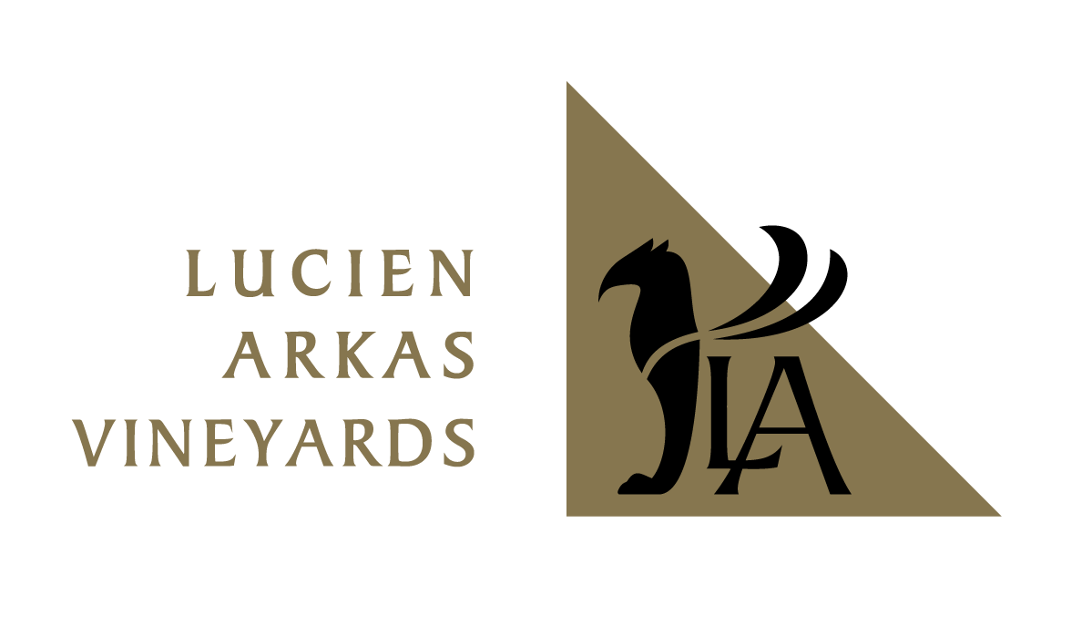
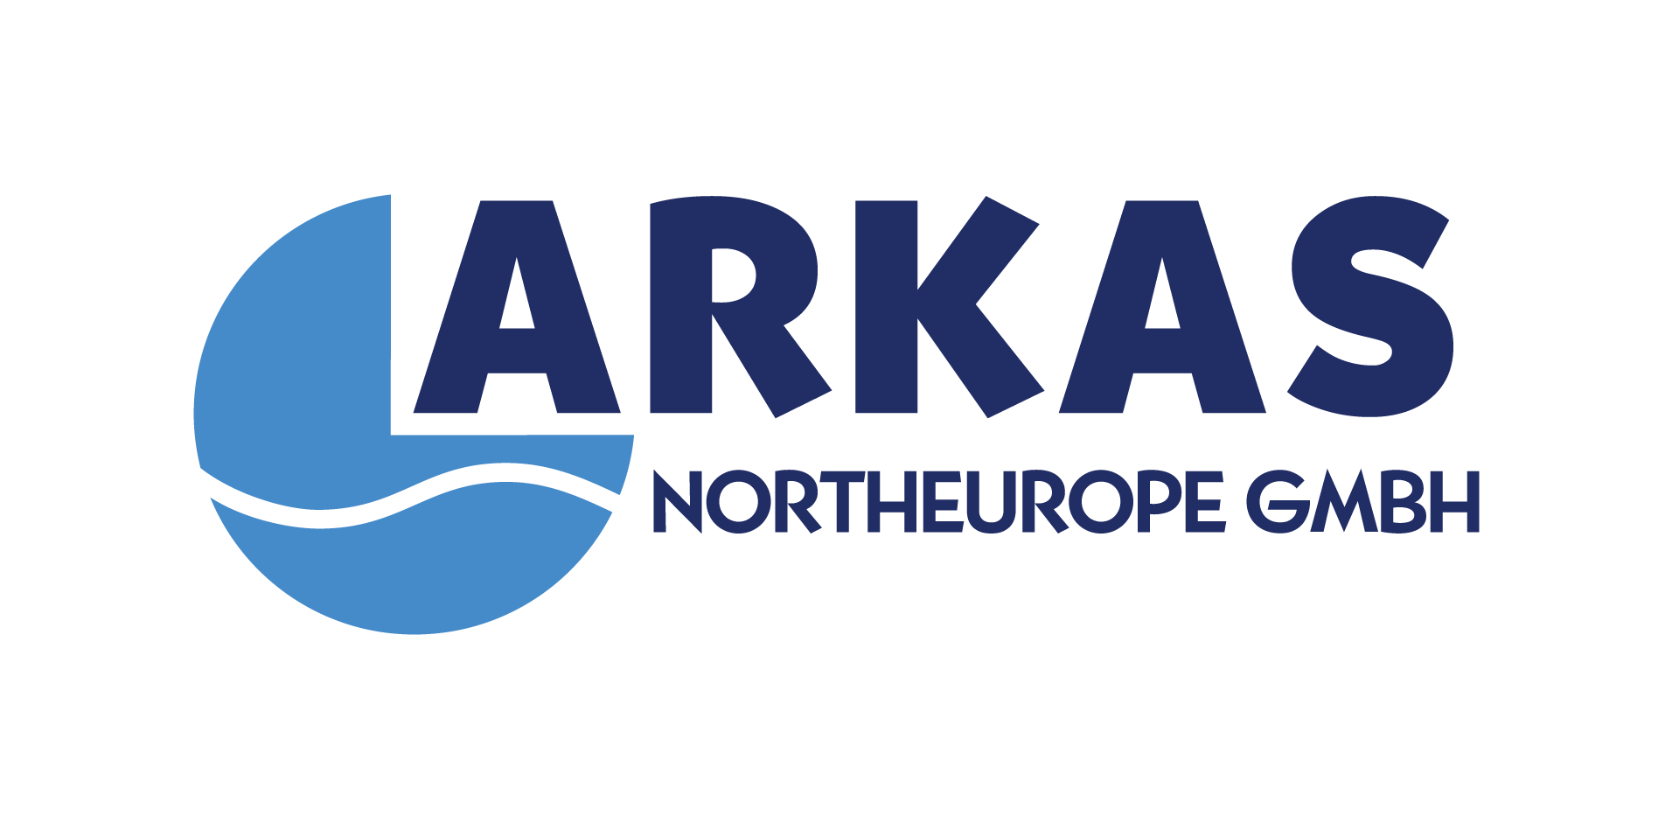
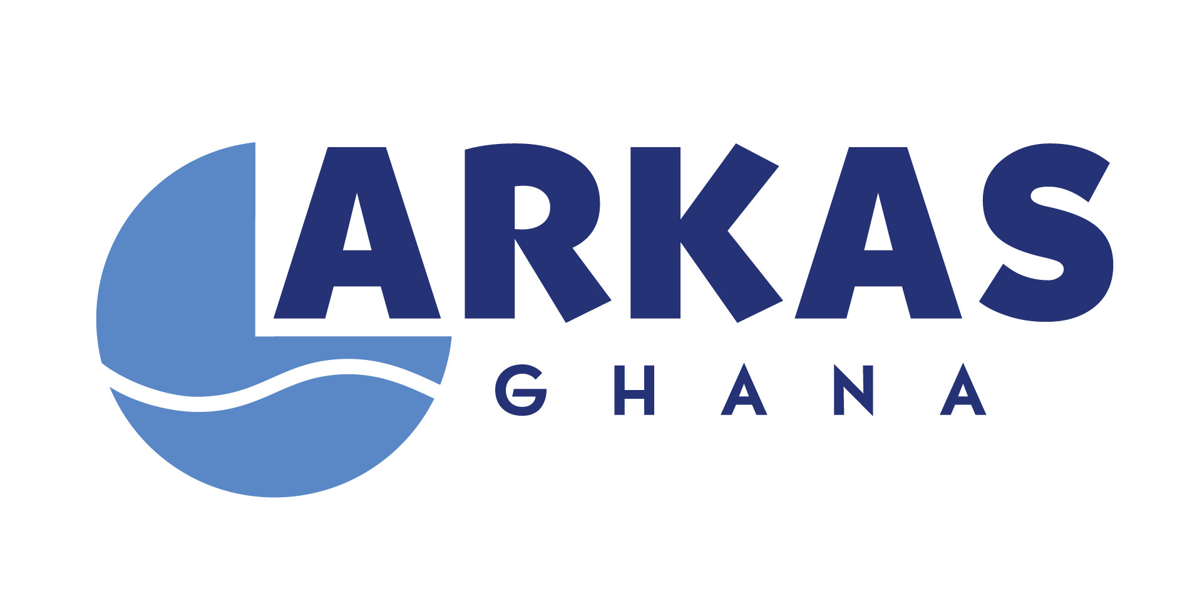
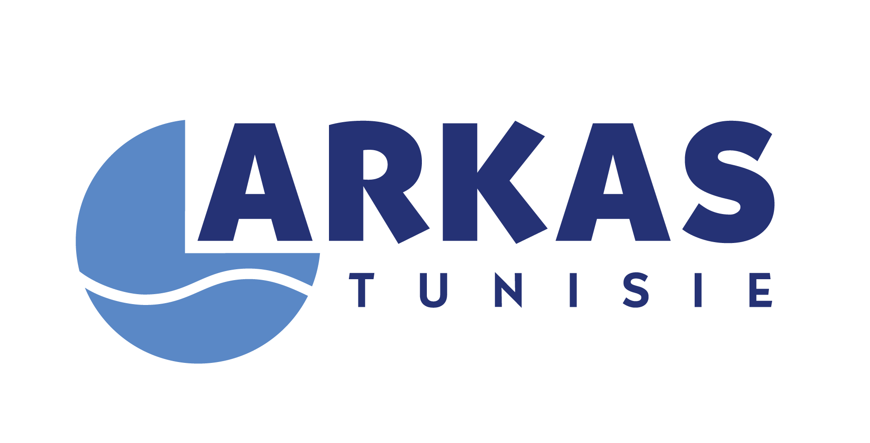
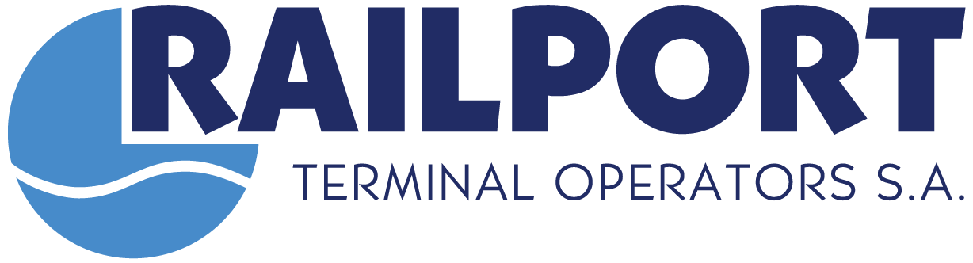
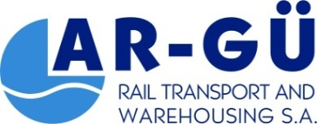
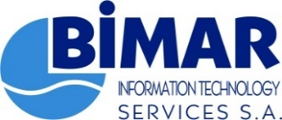

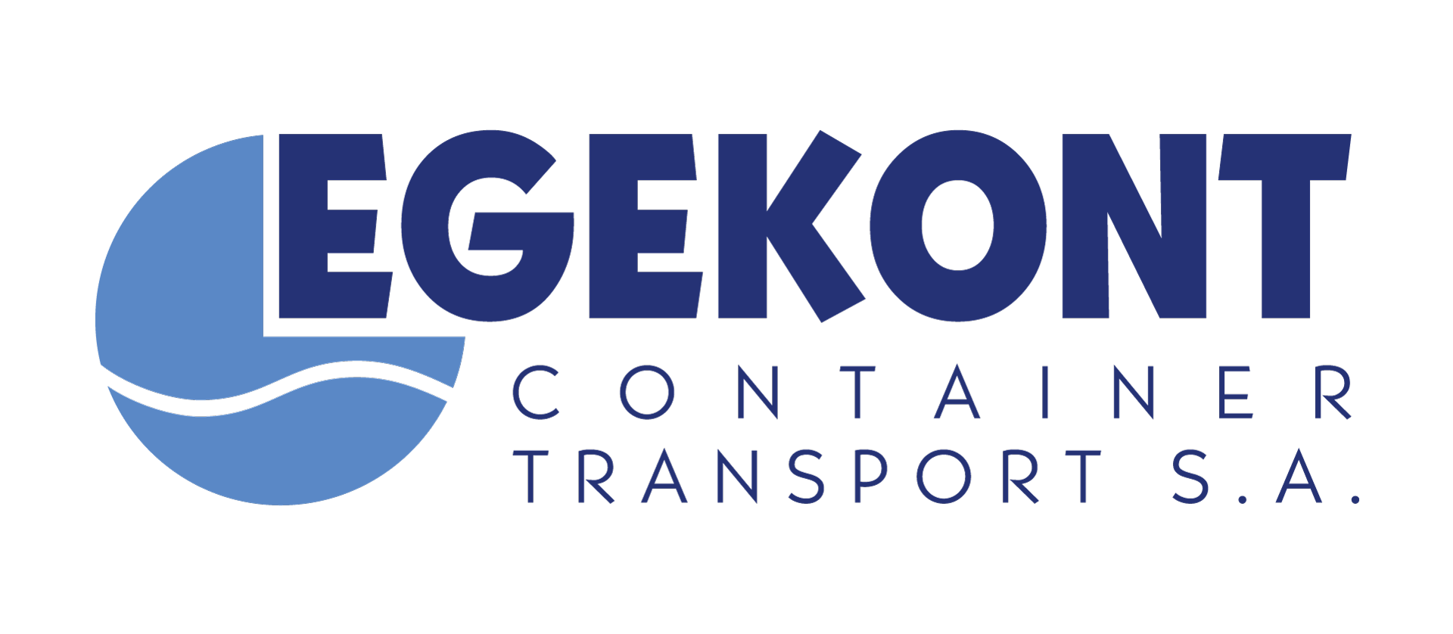
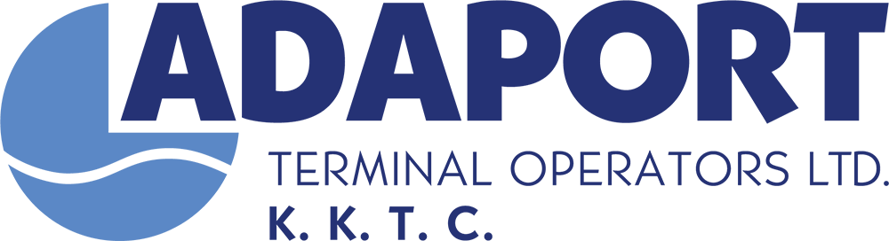
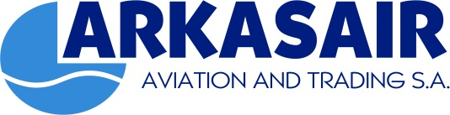

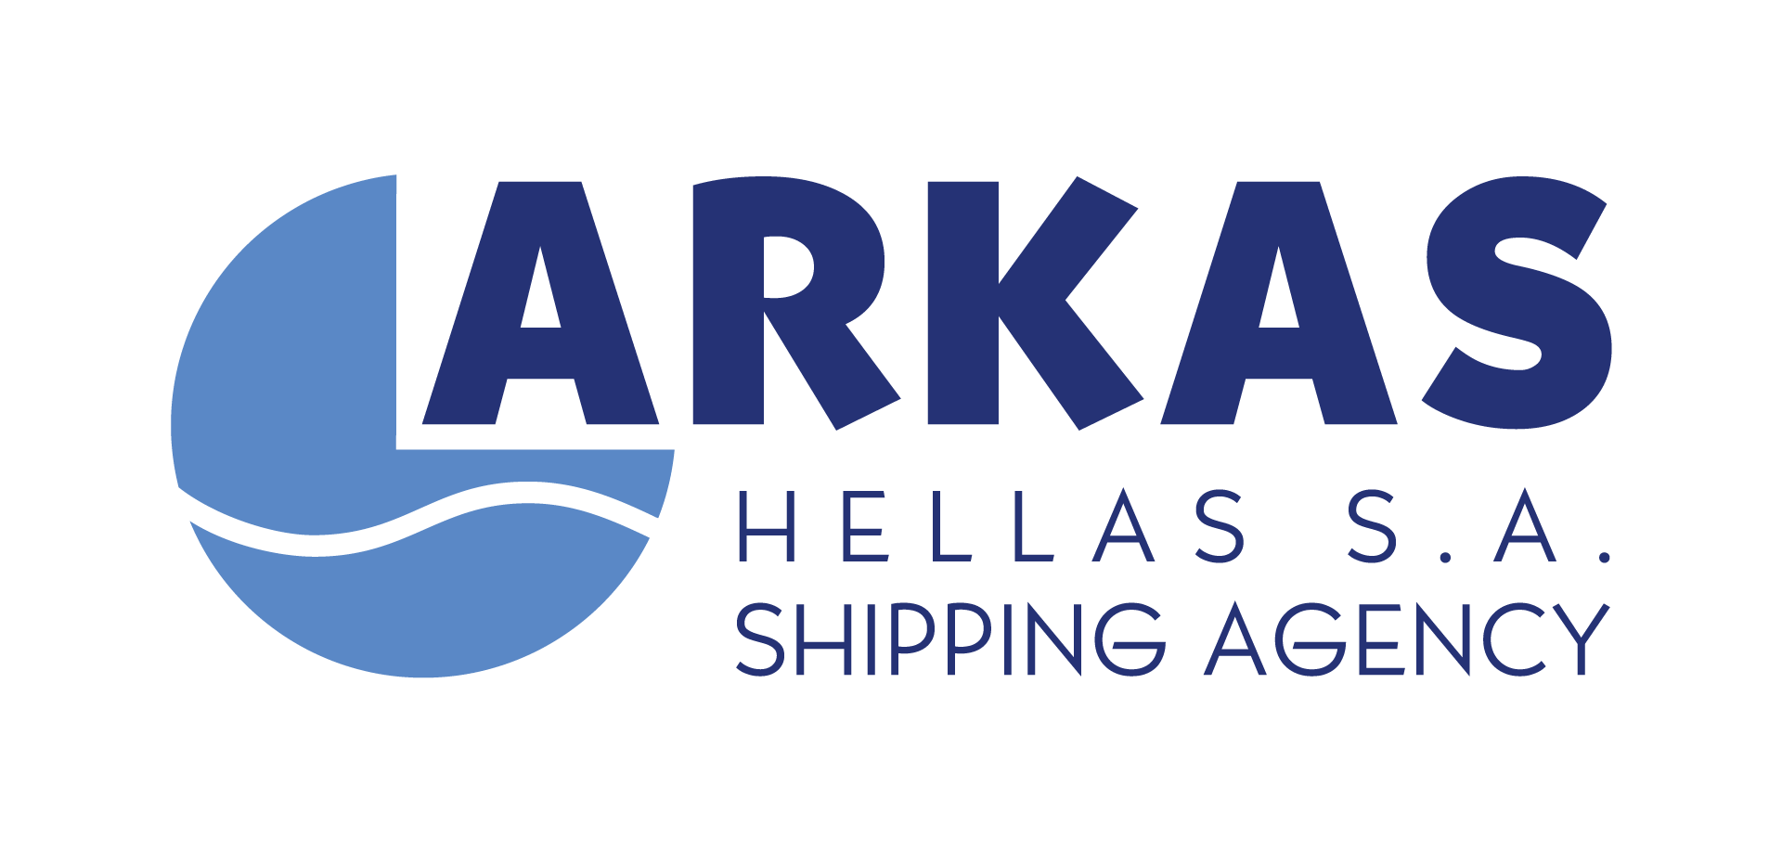
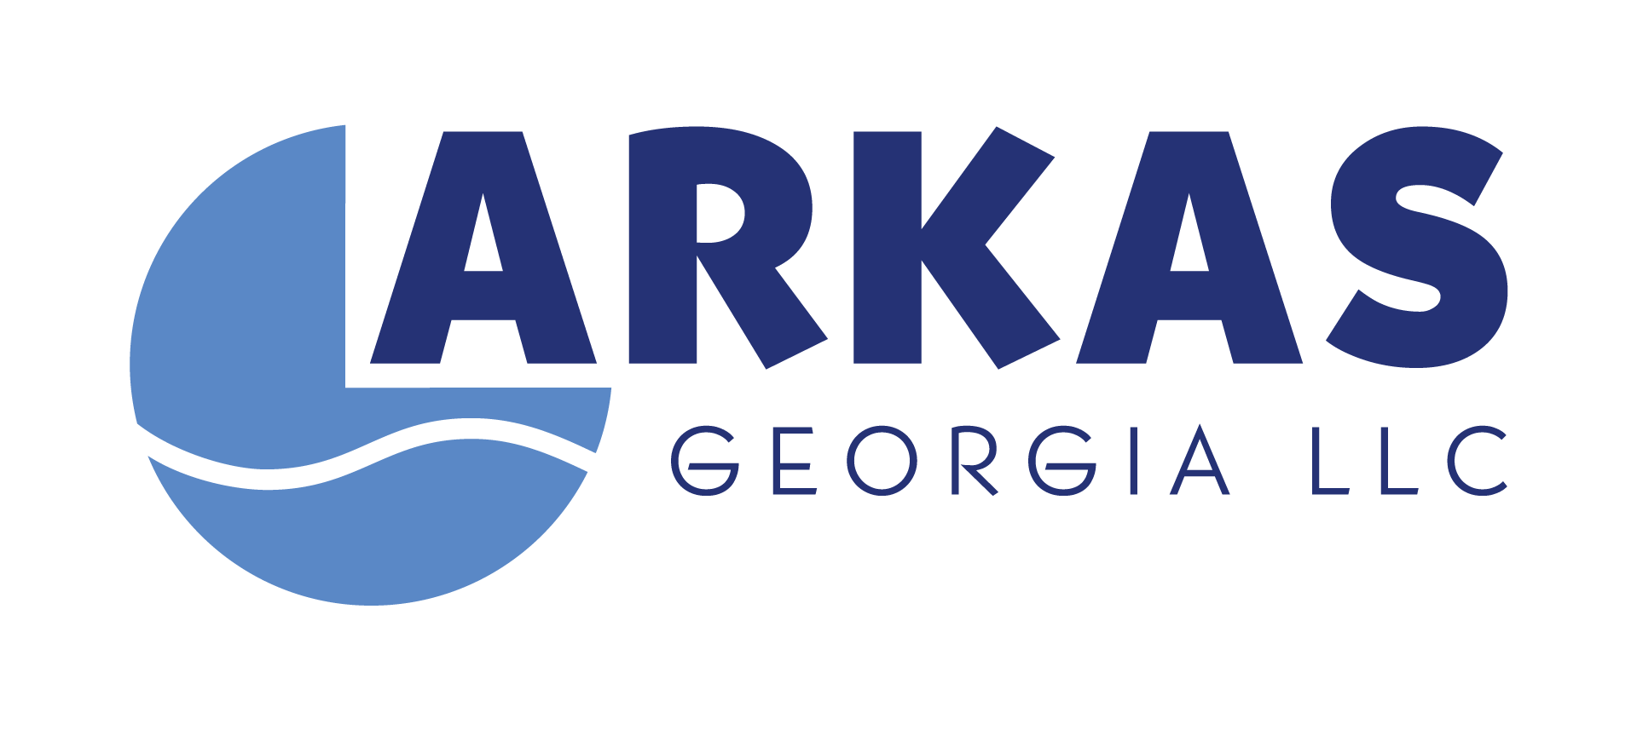

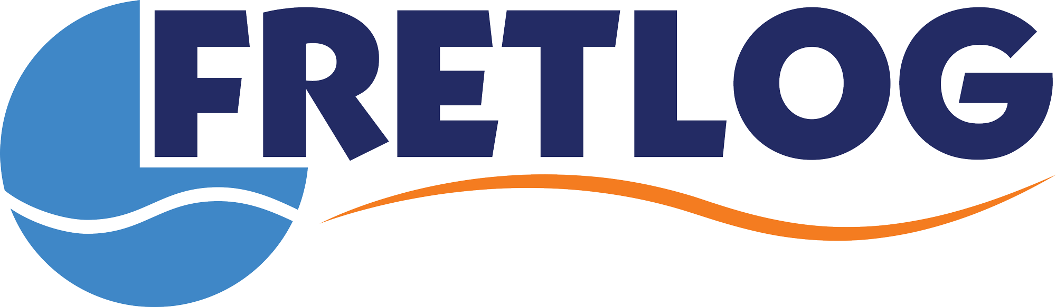
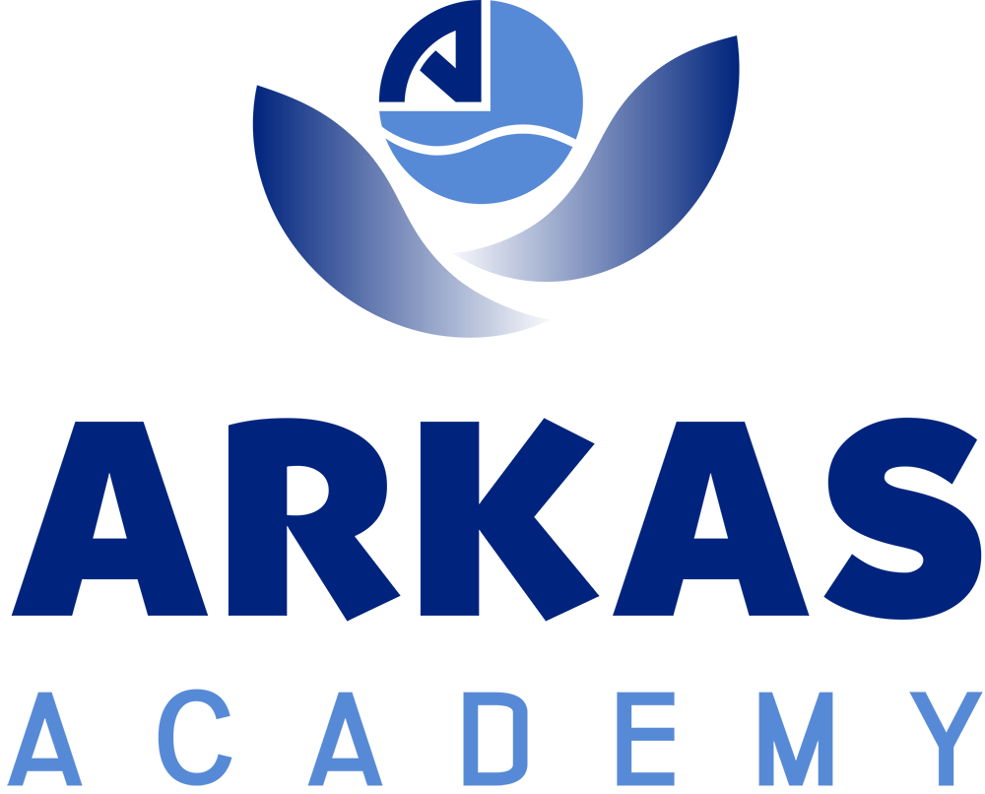
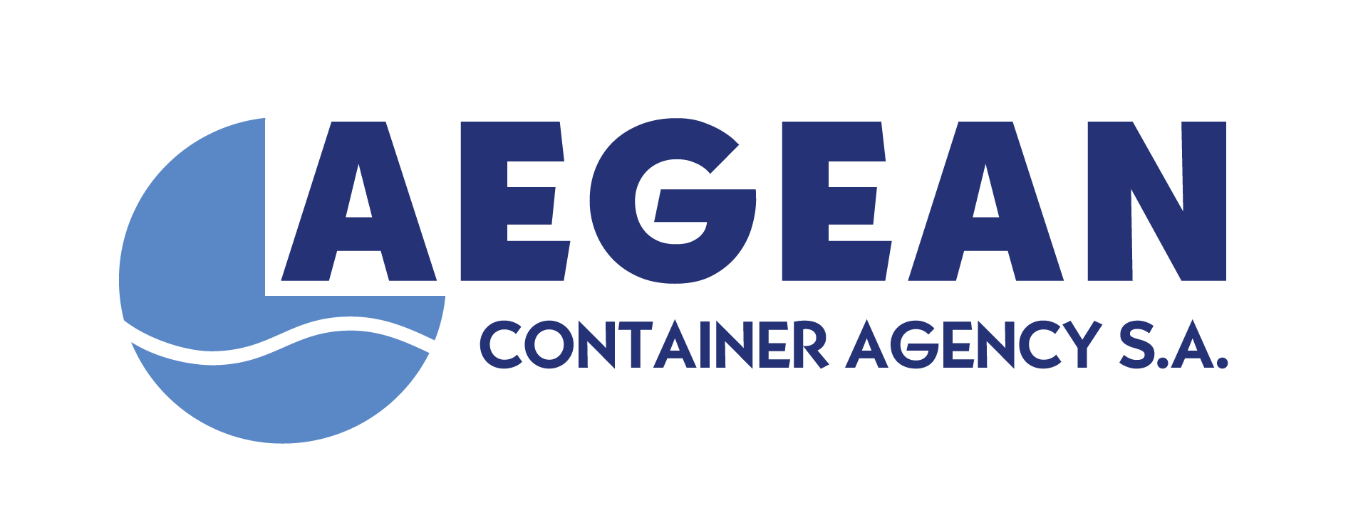
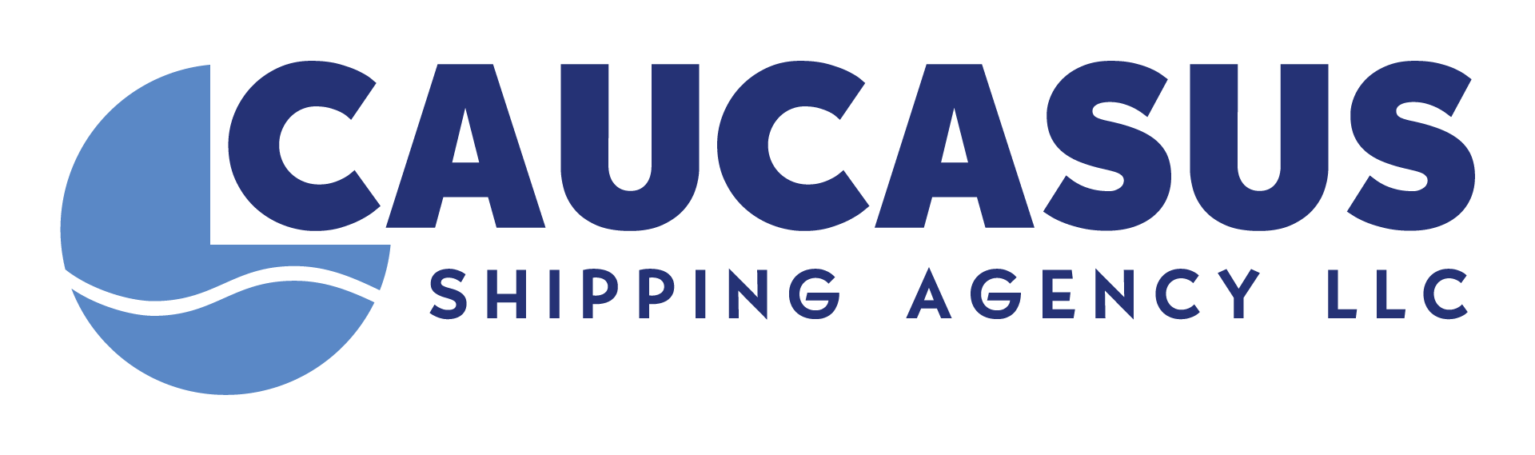
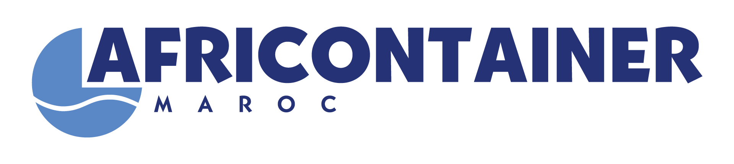
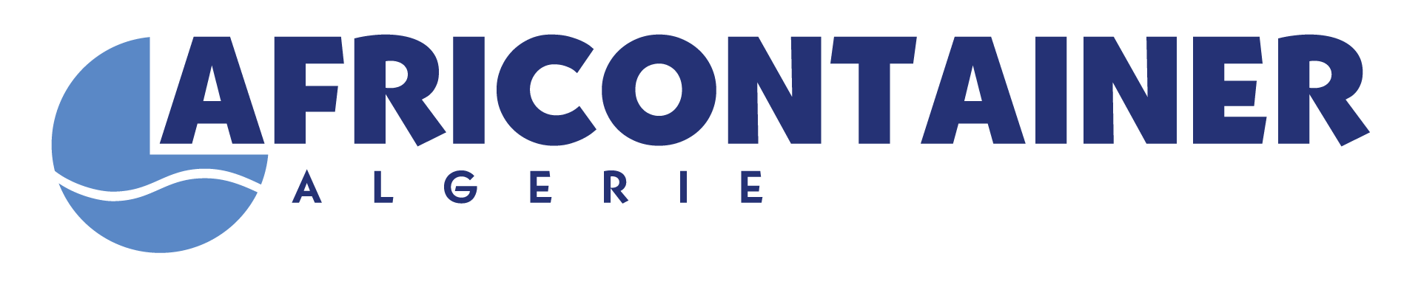
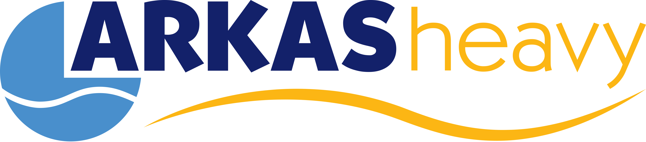








COMPANIES
SHIPPING
TERMINAL OPERATORS
LOGISTICS SERVICES
NON-CORE BUSINESS COMPANIES
SHIPOWNERS & SHIP MANAGEMENT SERVICES
AGENCY SERVICES
JOINT VENTURES and REPRESENTATIONS
JOINT VENTURES
Türkiye, Greece, Morocco, Ukraine
Türkiye
Türkiye, Greece
AGENCIES
Algeria
Greece, Morocco, Tunisia,
Libya, Algeria, Georgia
Bulgaria, Romania,
Ukraine, Russia, Georgia
Türkiye, Romania,
Ukraine

Slide 5

About Us
Operating since 2006, Arkas Bunker provides fast and reliable marine fuel supply services, built on the trust and quality associated with the Arkas brand. With a fleet of six double-hull tankers, all owned by the company and compliant with international standards, Arkas Bunker has supplied fuel to over 25,000 vessels to date.
As a pioneer in sustainability, Arkas Bunker is a member of the International Bunker Industry Association (IBIA) and is the first company in Türkiye to be awarded the International Sustainability and Carbon Certification (ISCC EU) in the marine fuels sector. The company also carried out Türkiye’s first biofuel supply.
Thanks to its strong collaborations and expert team, Arkas Bunker will continue to be your reliable partner in sustainable marine fuels, offering environmentally friendly services while prioritizing customer satisfaction, without compromising business ethics, and discipline.
ABOUT US

Slide 6

Our Services
With its expertise and reliability, Arkas Bunker provides services at ports worldwide:
Physical Marine Fuel Supply
i. Fuel Oil
ii. Marine Gas Oil
iii. Biofuels
Lubricant and Fuel Supply Brokerage Services
Vessel Chartering Services
OUR SERVICES

Slide 7

Supply Points
As a physical supplier, we provide top-quality service to vessels using our own double-hull tankers that meet international standards
Moreover, we supply fuels via trucks at all Turkish ports.
TÜRKİYE

Slide 8

Our Fleet
From 2006 until today, we have successfully supplied 6.4 million tons of fuels to over 25 thousand vessels.
4139 DWT
3799 DWT
1770 DWT
1763 DWT
1646 DWT
1634 DWT

Slide 9

Sustainability
In the broadest sense, sustainability refers to the ability to maintain and support a process consistently over time. Sustainability aims to prevent the exhaustion of natural and physical resources and thus ensure they stay available in the long term.
Sustainability is the ability to maintain or support a process in time.
Sustainability is commonly divided into three key concepts: economic, environmental and social.
Many businesses and governments are committed to sustainable goals such as reducing environmental footprints and protecting resources.
Some investors embrace sustainability investments known as «green investments».

Slide 10

ISCC EU
In February 2024, Arkas Bunker became Türkiye’s first ISCC-EU certified marine fuel supplier.
International Sustainability and Carbon Certification (ISCC-EU), is a multi-stakeholder enterprise that provides sustainability certification for all feedstock and markets on a global scale.
ISCC is directed by an association of over 230 members including research institutions, NGOs, industry representatives and the public sector.

Slide 11


Bio24F
Bio24F is a product of Arkas Bunker, composed of 24% used cooking oil (UCOME) and 76% fuel oil, certified by ISCC.
The bio component of Bio24F is valuable for its ability to significantly reduce life-cycle carbon emissions compared to traditional marine fuels.
The fuel oil part of the blend complies with the International Maritime Organization’s (IMO) regulations.
Biofuels, derived from biological sources, provide a sustainable alternative to fossil fuels and contribute significantly to the maritime industry’s sustainability goals.
Arkas Bunker has supplied Bio24F with more than 10 vessels to date.

Slide 12






Contact
 | arkasbunker.com
 | arkasbunker
 | arkasbunker
 | arkasbunker
Contact Us
CONTACT

